Slide 1
Durandal
Single Page Apps Done Right
@DurandalJS
Rob Eisenberg, Creator - Durandal
www.durandaljs.com

Slide 2
Agenda
What is it?
Where To Get It
The 3 Pillars
Key Concepts & Demos
Resources

Slide 3
SPA!?
What is it?

Slide 4
Where To Get It
Nuget
Install-Package durandal
Bower
bower install durandal
Mimosa
mimosa skel:new durandal
durandaljs.com
Raw Downloads and VSIX (Also in the VS Gallery)
github.com/bluespire/durandal

Slide 5
The 3 Pillars
jQuery
RequireJS
Knockout

Slide 6
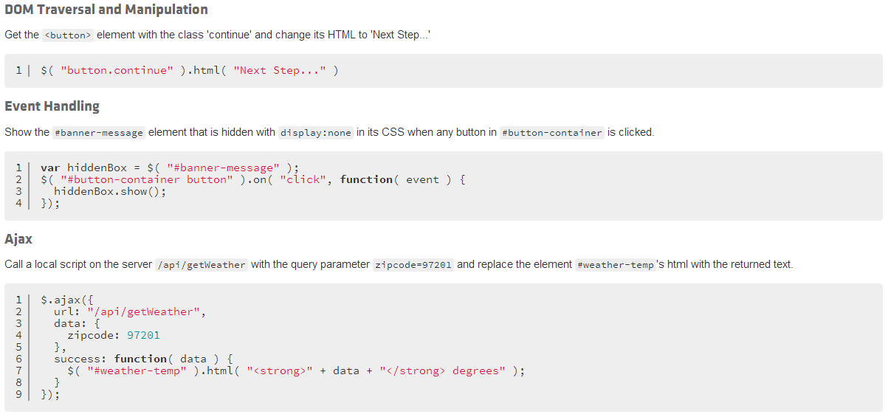
jQuery

Slide 7
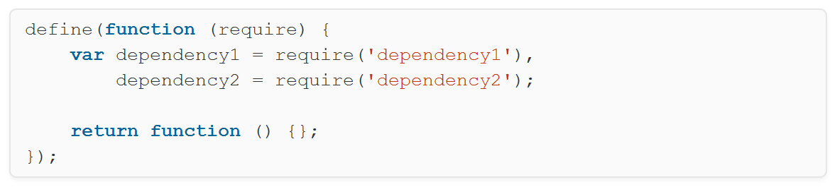
RequireJS
AMD
Wrap
Module Code

Slide 8
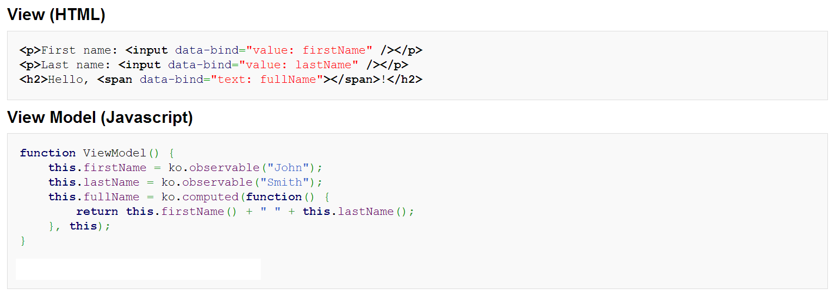
Knockout
Declarative Binding

Slide 9
The 3 Pillars
jQuery
RequireJS
Knockout

Slide 10
Key Concepts
Part 1
Modularization
Composition
Binding

Slide 11
DEMO

Slide 12
Key Concepts
Part 2
Lifecycle
Promises
Plugins
Everything else is just sugar…

Slide 13
Lifecycle
activate
bindingComplete
attached
binding
compositionComplete
detached
canActivate
canDeactivate
deactivate

Slide 14
DEMO

Slide 15
Resources
DurandalJS.com
Google Group
Commercial Support
On-Site Training
Pluralsight

Slide 16
Questions?

